Slide 1
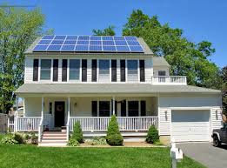
Go Green and Save Want to save money on your electric bill?
The City of Kansas City, Missouri and A1 Solar Source Inc., are sponsoring an information session on the benefits of and how to go about getting a renewable Photovoltaic system installed on your house rooftop.
Date/Time: | Location: | Address:
September 28 6:30 – 8:30pm | KCPD Shoal Creek Patrol Community Room | 6801 NE Pleasant Valley Road, 64119
If interested in attending, please register by 9/16 with:
charles.harris@kcmo.org (816) 513-2751.

